Slide 1
A Prophet on the Run A Lesson from God
The Book of Jonah
April 23, 2023

Slide 2
Jonah 4:1-5
¹ But it greatly displeased Jonah and he became angry. ² He prayed to the Lord and said, “Please Lord, was not this what I said while I was still in my own country? Therefore in order to forestall this I fled to Tarshish, for I knew that You are a gracious and compassionate God, slow to anger and abundant in lovingkindness, and one who relents concerning calamity. ³ Therefore now, O Lord, please take my life from me, for death is better to me than life.” ⁴ The Lord said, “Do you have good reason to be angry?” ⁵ Then Jonah went out from the city and sat east of it. There he made a shelter for himself and sat under it in the shade until he could see what would happen in the city.

Slide 3
Jonah 4:6-9
⁶ So the Lord God appointed a plant and it grew up over Jonah to be a shade over his head to deliver him from his discomfort. And Jonah was extremely happy about the plant. ⁷ But God appointed a worm when dawn came the next day and it attacked the plant and it withered. ⁸ When the sun came up God appointed a scorching east wind, and the sun beat down on Jonah’s head so that he became faint and begged with all his soul to die, saying, “Death is better to me than life.” ⁹ Then God said to Jonah, “Do you have good reason to be angry about the plant?” And he said, “I have good reason to be angry, even to death.”

Slide 4
Jonah 4:10-11
¹⁰ Then the Lord said, “You had compassion on the plant for which you did not work and which you did not cause to grow, which came up overnight and perished overnight. ¹¹ Should I not have compassion on Nineveh, the great city in which there are more than 120,000 persons who do not know the difference between their right and left hand, as well as many animals?”

Slide 5
A Prophet on the Run
I. Sovereign to Send
II. Sovereign to Save
III. Sovereign to Spare
IV. Sovereign to Scold

Slide 6
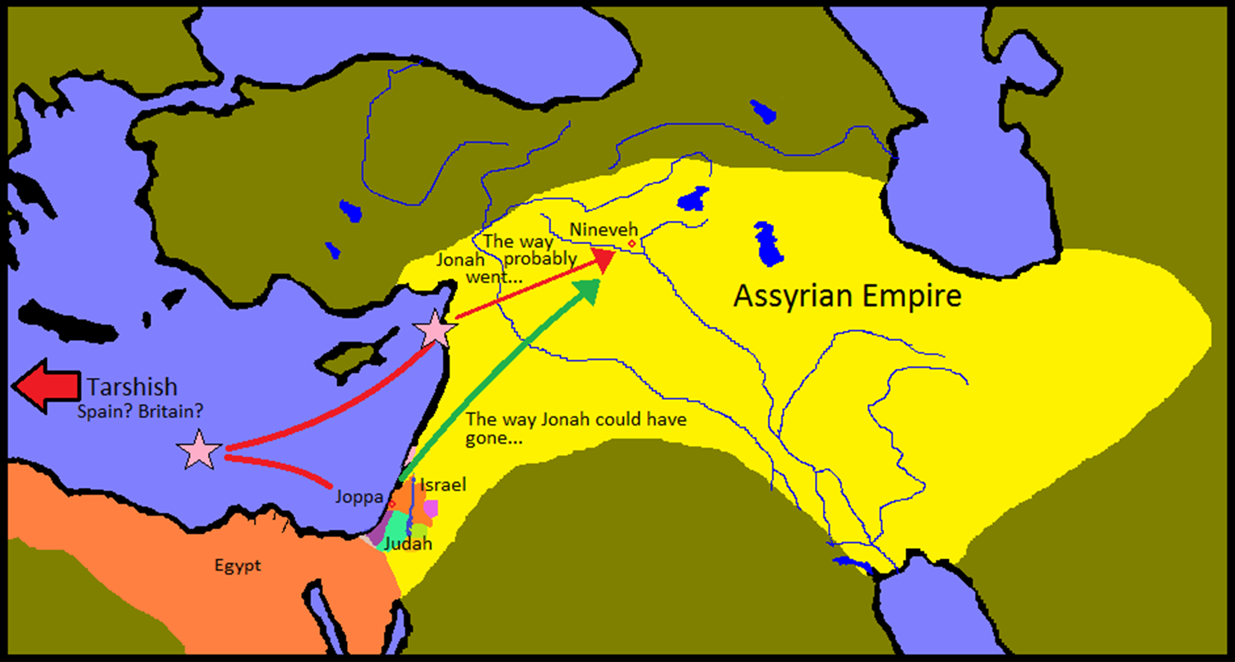
A Prophet on the Run

Slide 7
A Prophet on the Run
III. Sovereign to Scold (4:1-11)
A. Grace Given (4:1-4)

Slide 8
The Nature of God
Exodus 34:6
Then the Lord passed by in front of him and proclaimed, “The Lord, the Lord God, compassionate and gracious, slow to anger, and abounding in lovingkindness and truth.
Psalm 86:15
But You, O Lord, are a God merciful and gracious, slow to anger and abundant in lovingkindness and truth.
Joel 2:13
And rend your heart and not your garments.” Now return to the Lord your God, for He is gracious and compassionate, slow to anger, abounding in lovingkindness and relenting of evil.
Micah 7:18
Who is a God like You, who pardons iniquity and passes over the rebellious act of the remnant of His possession? He does not retain His anger forever, Because He delights in unchanging love.

Slide 9
A Prophet on the Run
III. Sovereign to Scold (4:1-11)
A. Grace Given (4:1-4)
1. Gracious – Unmerited Favor
2. Compassionate – Intimate compassion between a mother and child, between brothers
3. Slow to Anger – God’s immeasurable patience
4. Abounding in lovingkindness – Overflowing loyal love of God in the covenant relationship

Slide 10
A Prophet on the Run
III. Sovereign to Scold (4:1-11)
A. Grace Given (4:1-4)
B. Grace Taken (4:5-9)

Slide 11
A Prophet on the Run
III. Sovereign to Scold (4:1-11)
A. Grace Given (4:1-4)
B. Grace Taken (4:5-9)
C. Grace Explained (4:11)

Slide 12
1 John 4:19
We love, because He first loved us.

Slide 13
A Prophet on the Run
I. Sovereign to Send
II. Sovereign to Save
III. Sovereign to Spare
IV. Sovereign to Scold

Slide 14
A Prophet on the Run A Lesson From God
The Book of Jonah
April 23, 2023

